Slide 1
Brief Introduction to Natural Language Processing
Anoop Sarkar

Slide 2
Why is NLP computationally hard?

Slide 3
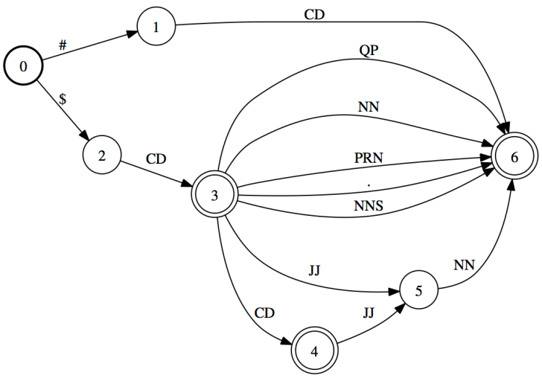
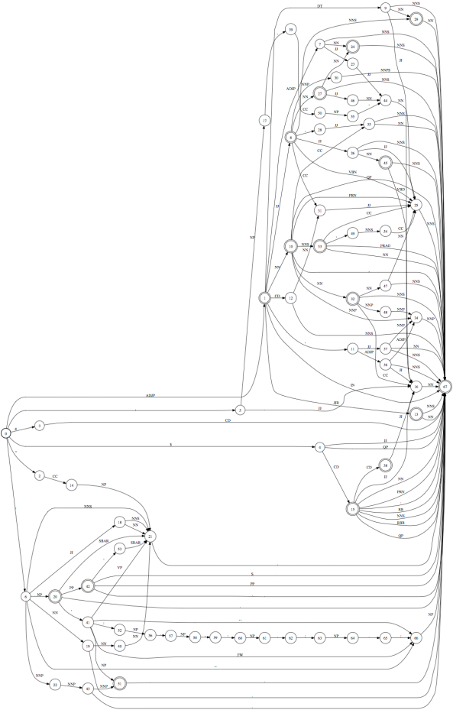
JJ
NN
NN
noun phrase type
bronchial
brush
specimen
perthoracic
needle
aspiration
10 noun phrase types
100 noun phrase types
6K noun phrase types
Language is complex
1000 noun phrase types

Slide 4
Language is ambiguous
Lung cancer in women mushrooms
Mushrooms is noun or a verb?
Ban on nude dancing on governor's desk
Similar to common ambiguity in programming languages
Island Monks Fly in Satellite to Watch Pope Funeral
“fly in” vs. “fly [_{OBJ} in Satellite]” hidden segmentation
British Left Waffles on Falkland Islands
Is it British/Noun Left/Verb or British Left/NP Waffles/Verb?

Slide 5
Language is Parsed
for more see crashblossoms.com
Google's Computer Might Betters Translation Tool
New York Times March 8, 2010
Number of Lothian patients made ill by drinking rockets
Edinburgh Evening News, March 4, 2010
Violinist linked to JAL crash blossoms
http://languagelog.ldc.upenn.edu/nll/?p=1693

Slide 6
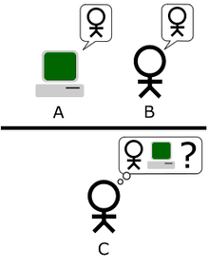

Imagine an "Imitation Game," in which a man and a woman go into separate rooms and guests try to tell them apart by writing a series of questions and reading the typewritten answers sent back. In this game both the man and the woman aim to convince the guests that they are the other.
We now ask the question, "What will happen when a machine takes the part of A in this game?" Will the interrogator decide wrongly as often when the game is played like this as he does when the game is played between a man and a woman? These questions replace our original, "Can machines think?"
Alan Turing

Slide 7
Winograd Schema
(H. Levesque, AAAI 2011)
The town councillors refused to give the angry demonstrators a permit because they feared violence.
Who feared violence?
Answer 0: the town councillors
Answer 1: the angry demonstrators
The town councillors refused to give the angry demonstrators a permit because they advocated violence.
Who advocated violence?
Answer 0: the town councillors
Answer 1: the angry demonstrators

Slide 8
What is the difference?
NLP = Natural Language Processing
Building useful systems
CL = Computational Linguistics
Understanding human language

Slide 9
Some examples of NLP tasks

Slide 10
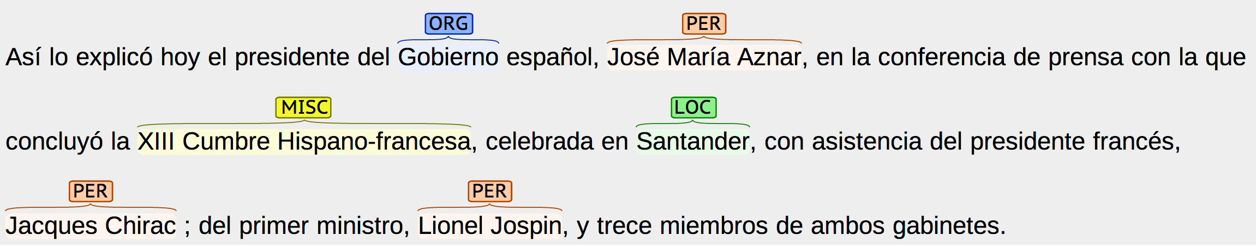
Information Extraction

Slide 11
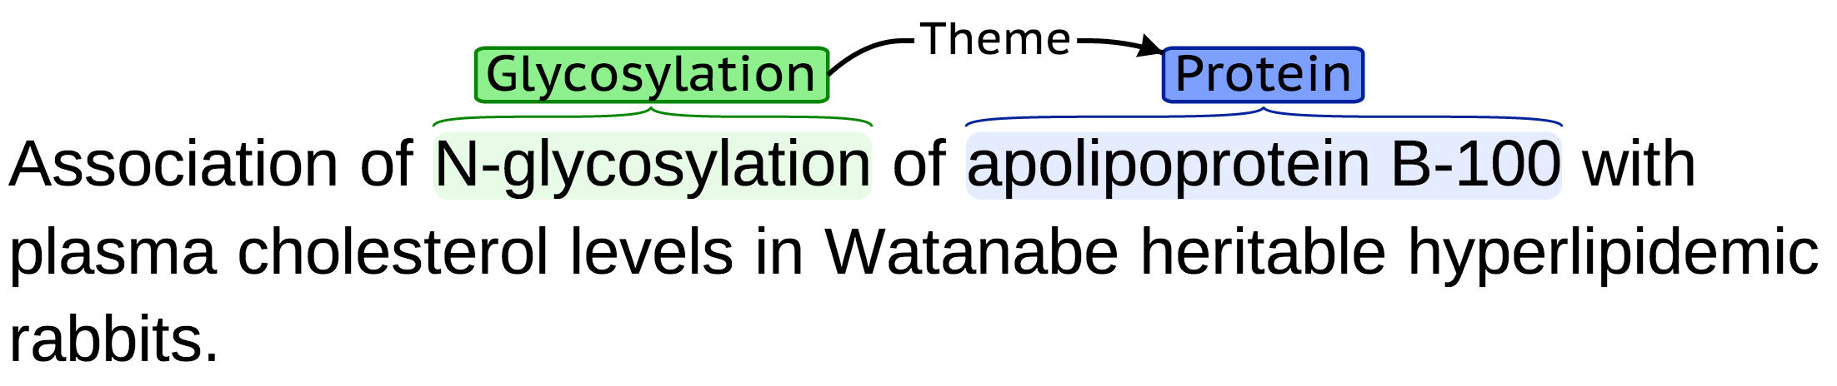
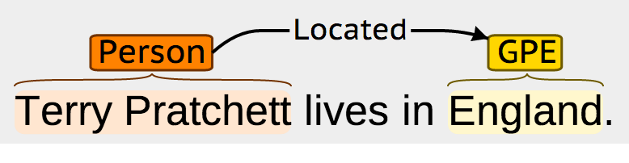
Information Extraction

Slide 12
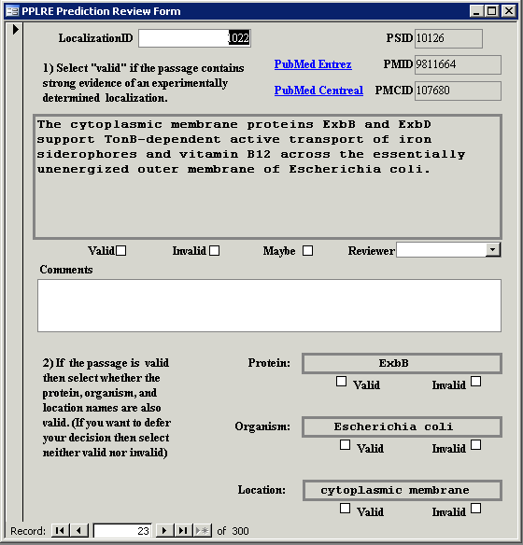

Slide 13
PICO frames (Cochrane)

Slide 14
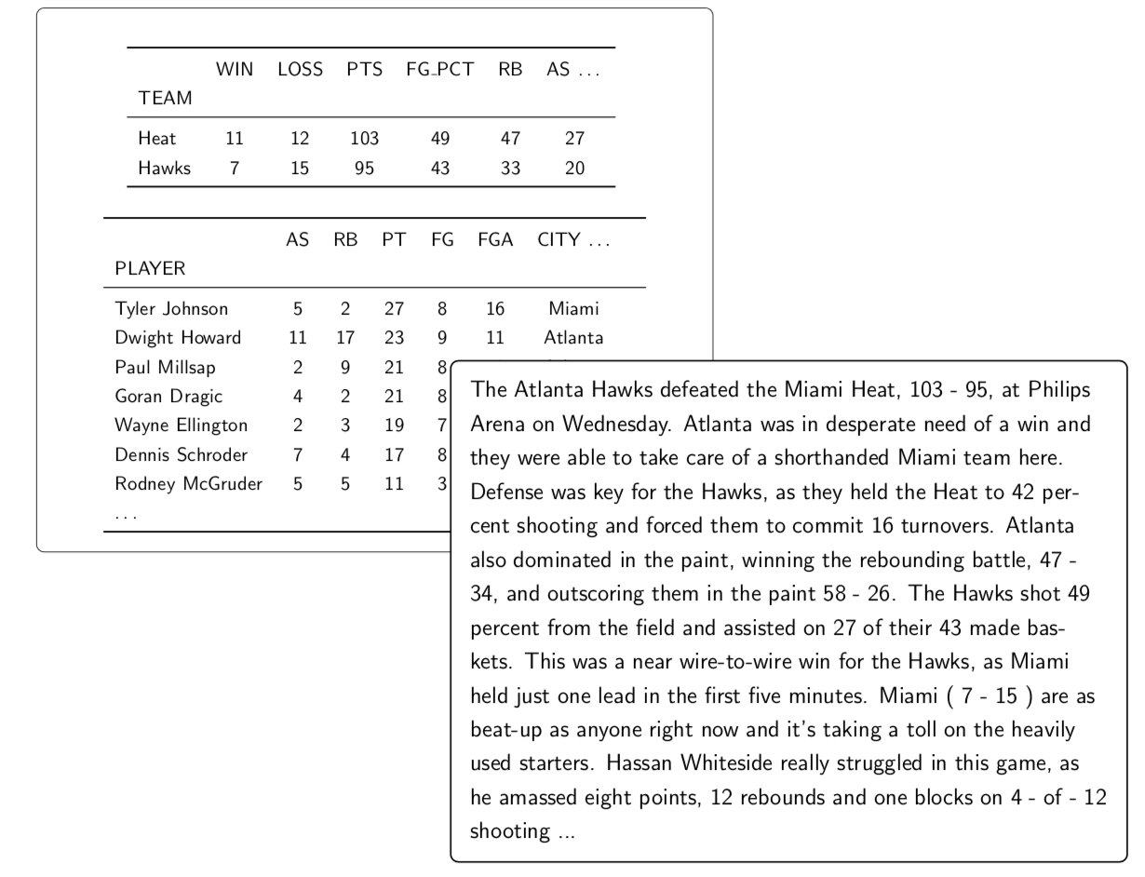
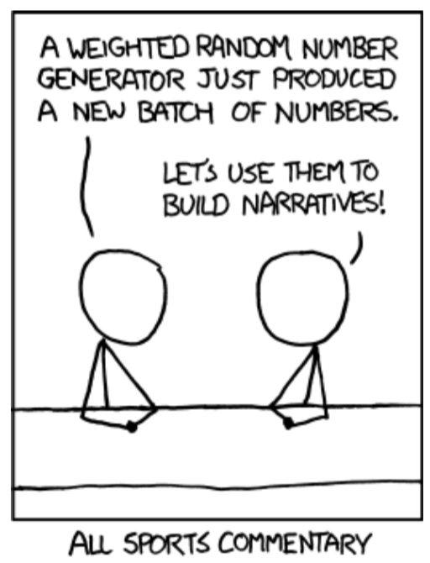
Natural Language Generation

Slide 15
Natural Language Generation
Primary finding: 23x18 mm nodule in right upper node
Features: Mixed solid and ground glass attenuation. >2cm from carina. No atelectasis. Contains visceral pleura. Satellite micronodule in same lung.
Additional Findings: 15mm right paratracheal node; 10mm subcarinal node. Small right pleural effusion. No visible metastases. Subpleural interstitial fibrosis.
Conclusion: Probable primary lung cancer. Clinical stage: Stage IV. Other differential: Fungal infection.

Slide 16
Natural Language Inference (NLI)
Samples from the MedNLI Corpus

Slide 17
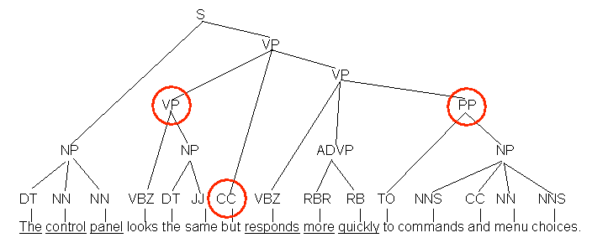
Sentence Compression

Slide 18
Paraphrasing
open borders imply increasing racial fragmentation in european countries .
open borders imply increasing racial fragmentation in the countries of europe .
open borders imply increasing racial fragmentation in european states .
open borders imply increasing racial fragmentation in europe .
open borders imply increasing racial fragmentation in european nations .
open borders imply increasing racial fragmentation in the european countries .

Slide 19
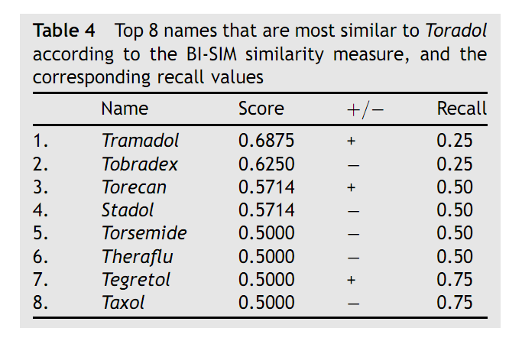
Identifying confusable drug names
G. Kondrak and B. Dorr

Slide 20
Deep Learning (neural networks) for NLP

Slide 21
It's a black box
class
Represent sparse discrete data like words as dense vectors
Creates natural groups due to the classification
Tokens can be words, characters, documents, …
token

Slide 22
Inside are more black boxes
What makes a neural network?
class
2. Each layer is a vector of numbers transformed into the next layer using a matrix operation
1. Multiple layers / “deep” networks model combinations of features
3. Each transfer from one layer to another is non-linear
token

Slide 23
Generalize to sequences
class
class
class
class
class
Hidden layer
Word embedding
token
token
token
token
token

Slide 24
Demos

